Slide 1
33a – Clean Code – Façade and Mediator Patterns
Based on the CleanCoders videos by Uncle Bob Martin
Rupert Waldron

Slide 2
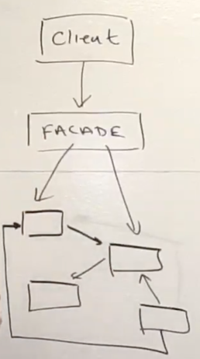
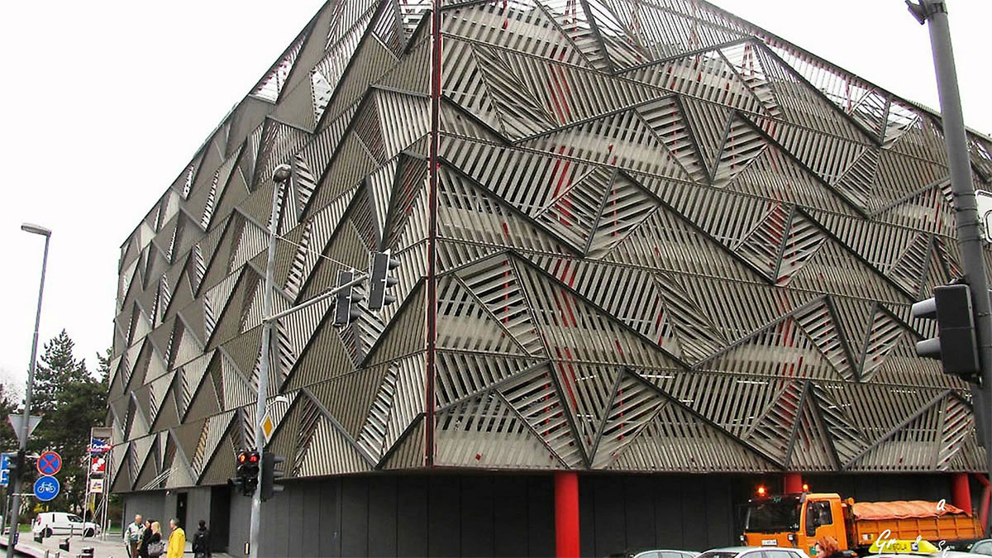
Façade Pattern
The façade pattern gives the client the ability to communicate with a group of objects through a carefully controlled interface – thus imposing a policy on the client from above.
The Façade controls the interaction of the client with the group of objects
Group of objects that are communicating with each other

Slide 3
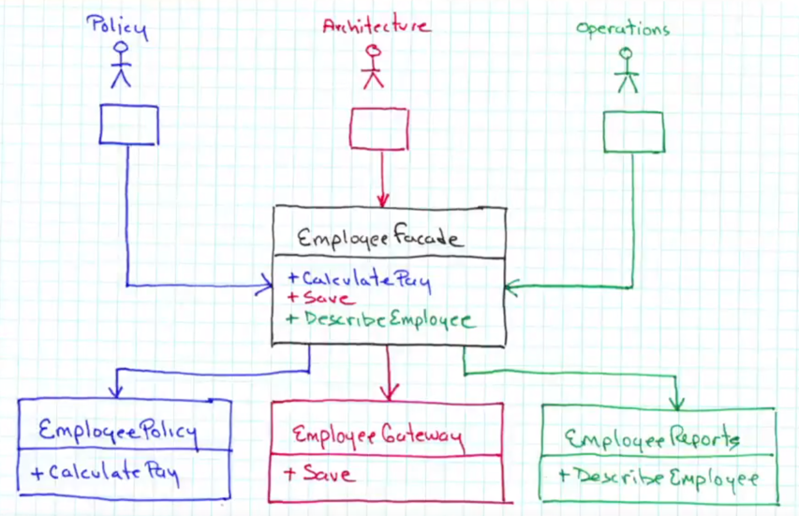
Façade Pattern
Here we used a Façade to spilt up the Employee class and enforce the separation below. The client will still see a familiar interface.
The Façade will control what the clients are allowed to ask for and how the classes contained within are allowed to respond.
The Façade stands in for the low-level implementation, providing a simpler and more constrained interface for the clients to use: simplify, secure
See the code

Slide 4
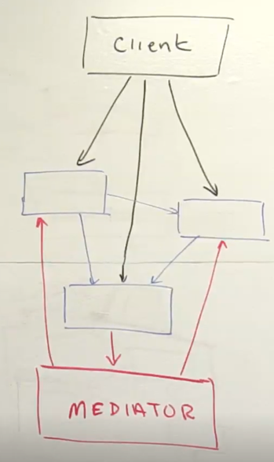
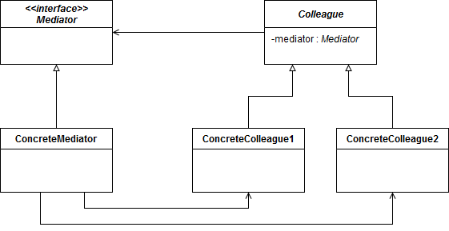
Mediator Pattern
The mediator pattern imposes policy from behind the scenes where you can’t see what is going on.

Slide 5
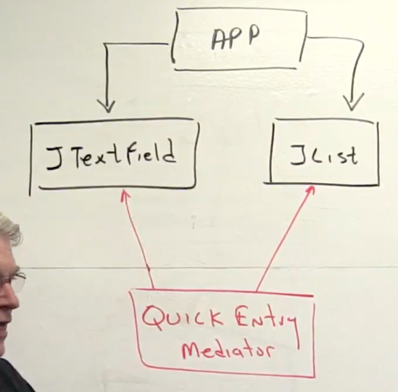
Mediator Pattern
The mediator prevents the objects interfering with each other explicitly.
JTextField and JList don’t know anything about each other. All the interaction is controlled by the Mediator
See the code

Slide 6
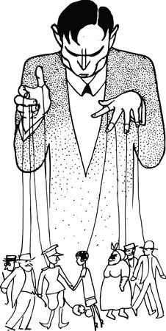
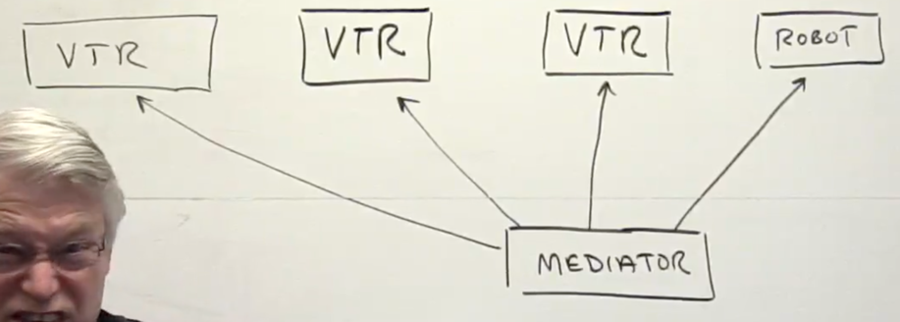
Mediator Pattern – TV Station example
The mediator works behind the scenes to impose a particular policy on a group of objects, neither of those objects knows anything about the mediator / puppeteer
The Tv station video tape robot example. The VTRs are changed by the robot part way through a film if the film can’t fit on one tape. Adverts can also be inserted. The mediator controls everything, as a VTR will send an event when the tape is about to run out. The VTRs and the robot know nothing about the mediator

Slide 7

Flyweight Pattern
The Flyweight pattern is used when you have a large number of objects which share a certain amount of fixed states
Imagine a lawn mower manufacturer with mowers in a catalogue, you wouldn’t have a different object for each mower…
You could have one object that represents the product type - that stored the make and the model, price and the picture
You could have another object that holds the produce instance with serial number, batch number and manufactured date
The flyweight (comes from the weight of a winged insect) isn’t called flyweight because it is light, it is called flyweight, because it’s ‘weight’ is shared amongst so many other objects, so to each object it is effectively light.

Slide 8
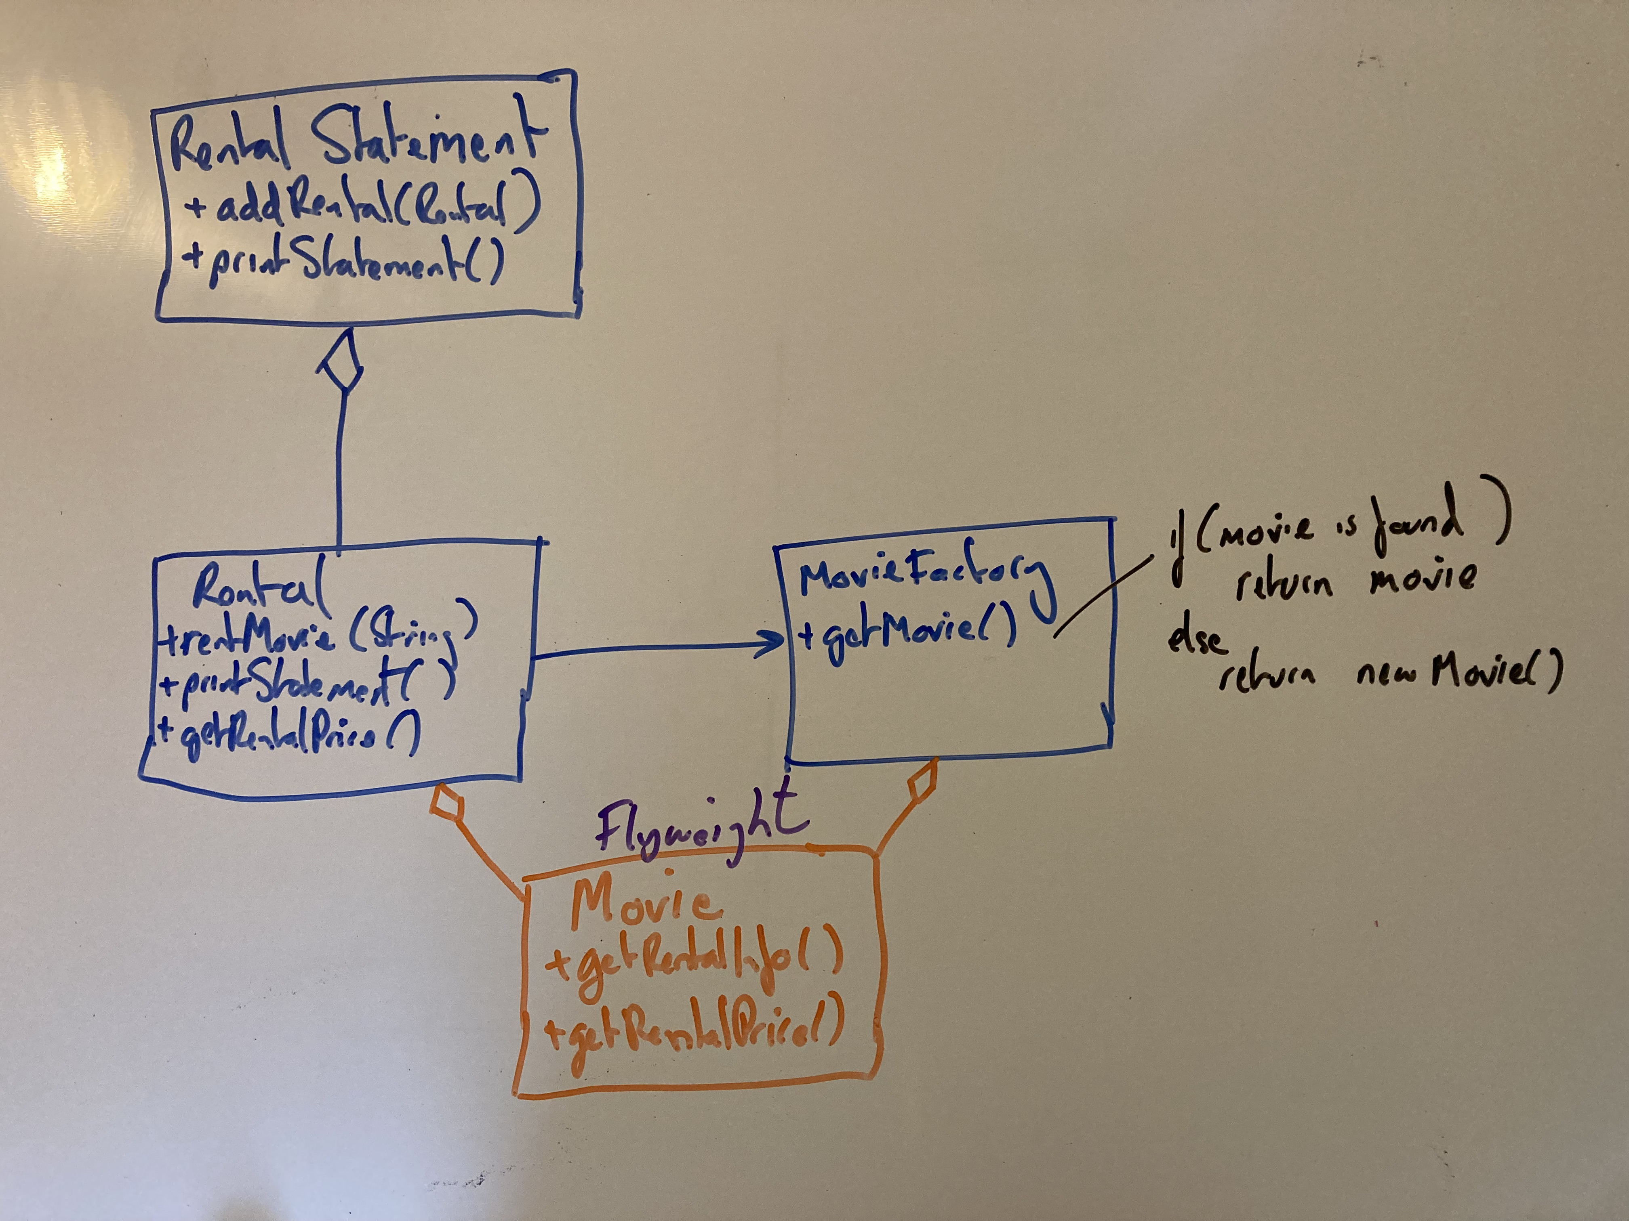
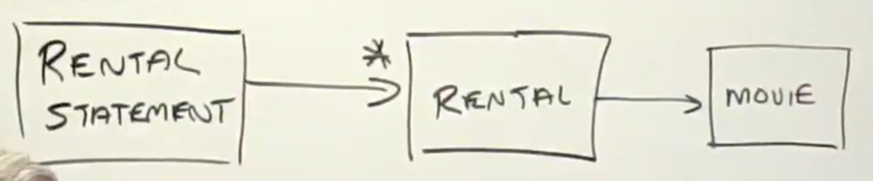
Flyweight Pattern – Movie Rental Example
The movie shares the state of every rental of that movie
See the code

